Slide 1

PREZOOM
Class
Iteration 0
Wireframe
Sequence
State
Use Case
Divide
DEVELOPED BY – TEAM BRAVO
Damini, Shujana, Preethi, & Utkarsh

Slide 2
Damini Prajapati
UML Class Diagrams
Use Case Diagrams
Shujana Mostafa
State Diagrams
User Stories
Class
Christiani Monisha Preethi
Wireframe
Divide
State
Sequence
Use Case
Sequence Diagrams
Lexicon
Utkarsh Trivedi
Wire Frame Diagrams
Repository
List of Requirements
PPT

Slide 3
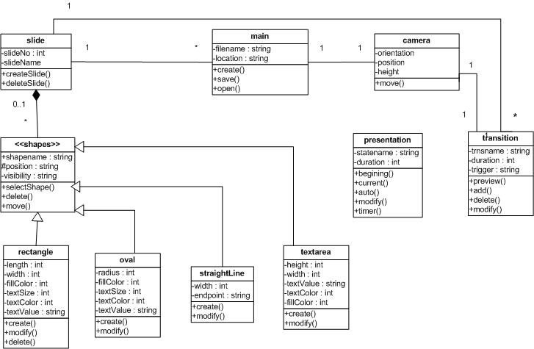
Wireframe
Class
Sequence
State
Use Case
Divide

Slide 4
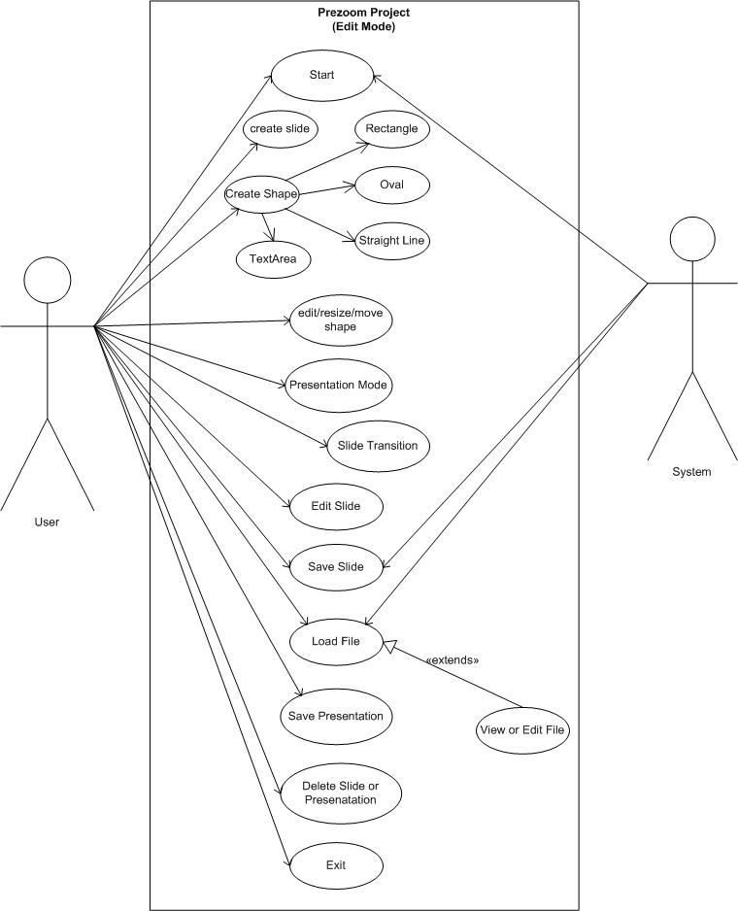
Wireframe
Class
Sequence
State
Use Case
Divide

Slide 5
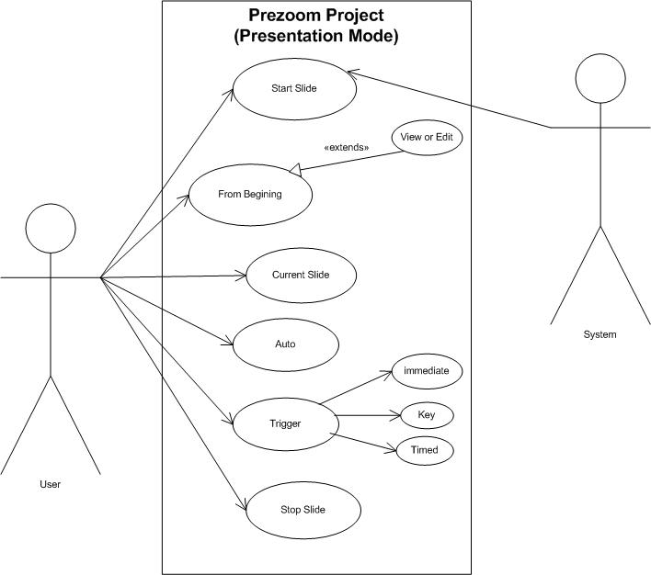
Wireframe
Class
Sequence
State
Use Case
Divide

Slide 6
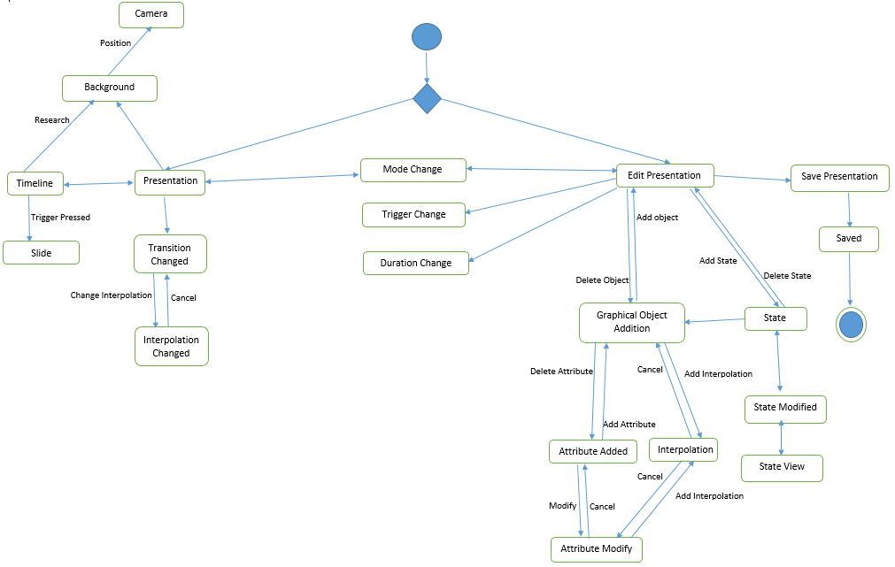
STATE DIAGRAM
Wireframe
Class
Sequence
State
Use Case
Divide

Slide 7
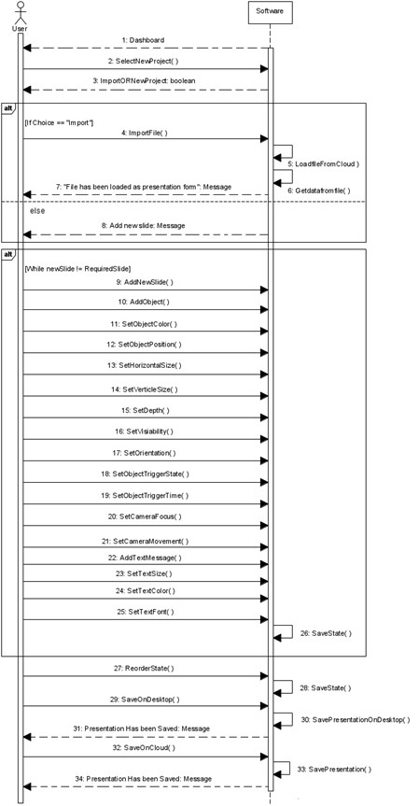
PRESENTATION
DEVELOPMENT
Wireframe
Sequence
Class
State
Use Case
Divide

Slide 8
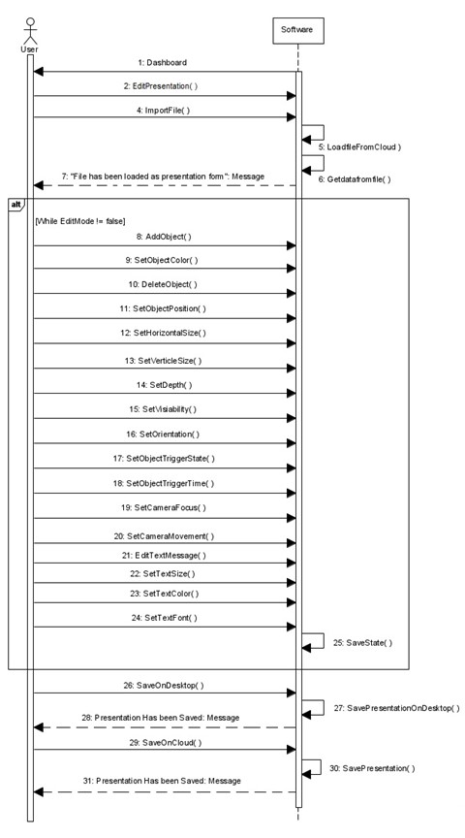
EDIT
PHASE
Wireframe
Sequence
Class
State
Use Case
Divide

Slide 9
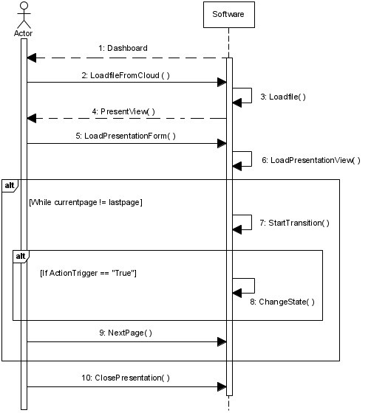
PRESENTATION
PHASE
Wireframe
Sequence
Class
State
Use Case
Divide

Slide 10
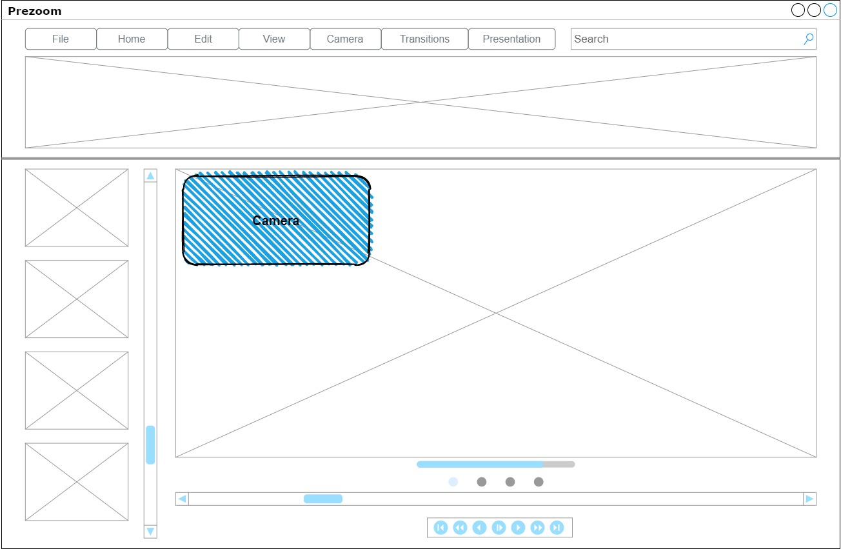
Main Window
Sequence
Class
State
Wireframe
Use case
Divide

Slide 11
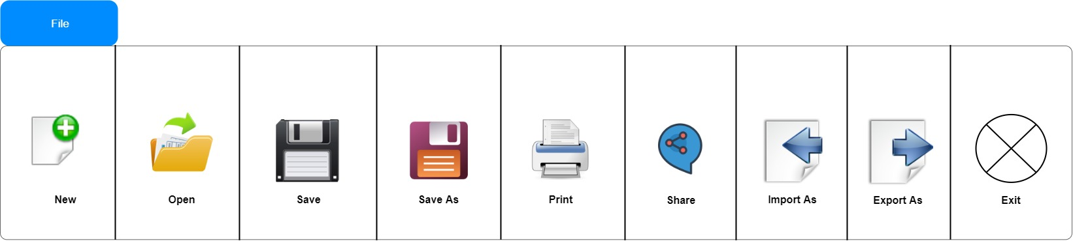
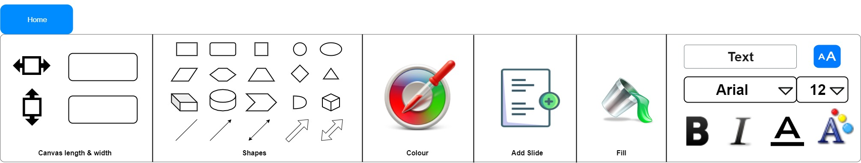
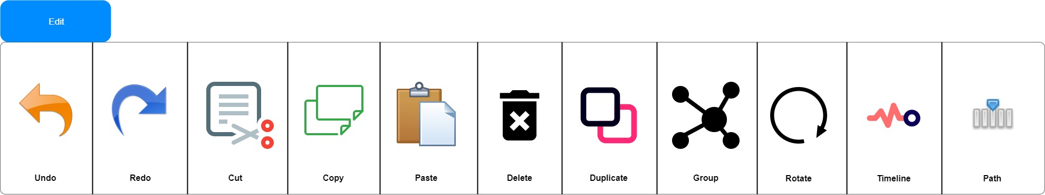
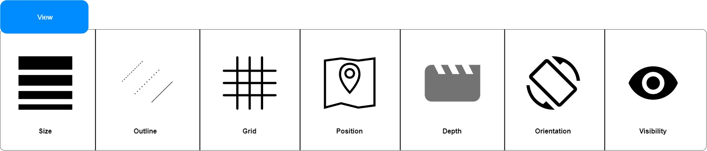
Sequence
Class
State
Wireframe
Use case
Divide

Slide 12
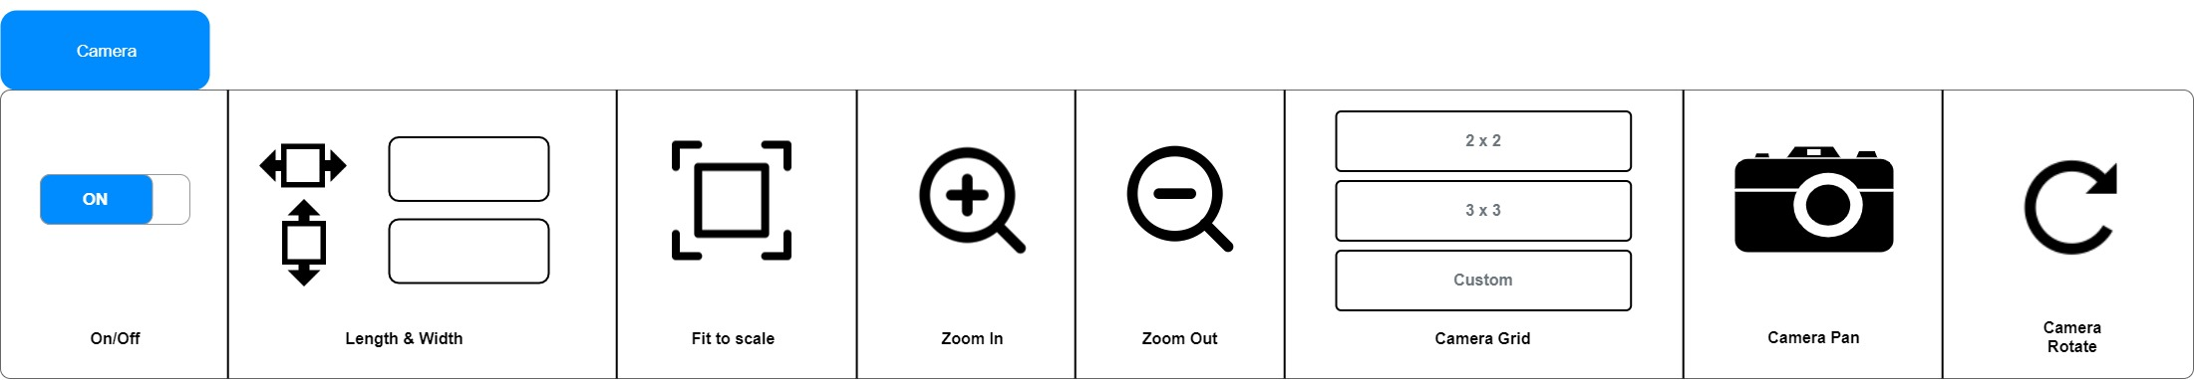
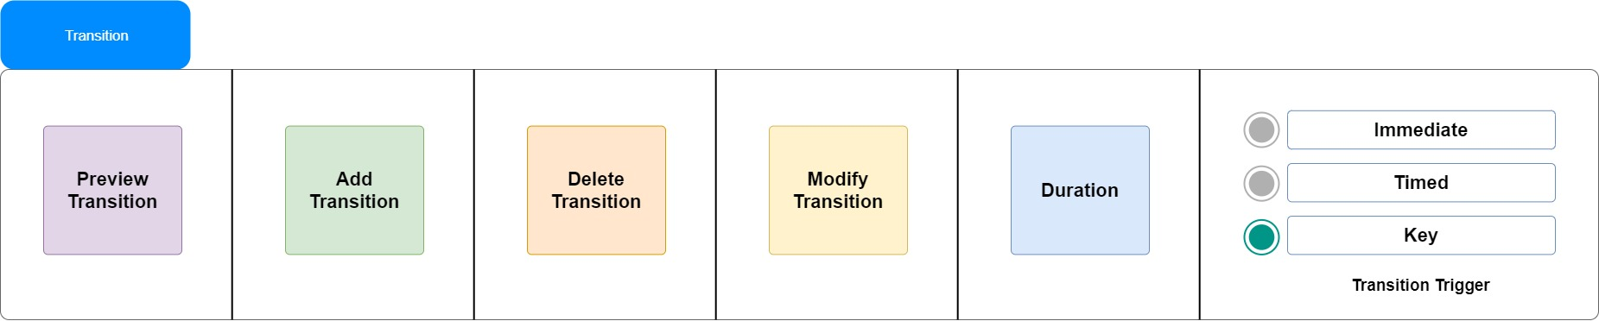
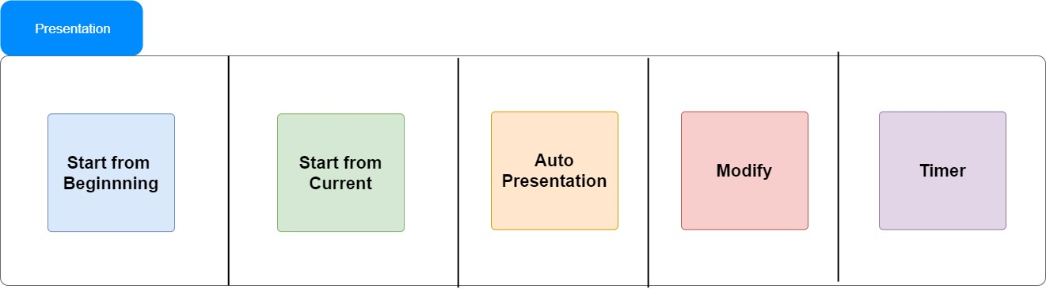
Sequence
Class
State
Wireframe
Use case
Divide

Slide 13
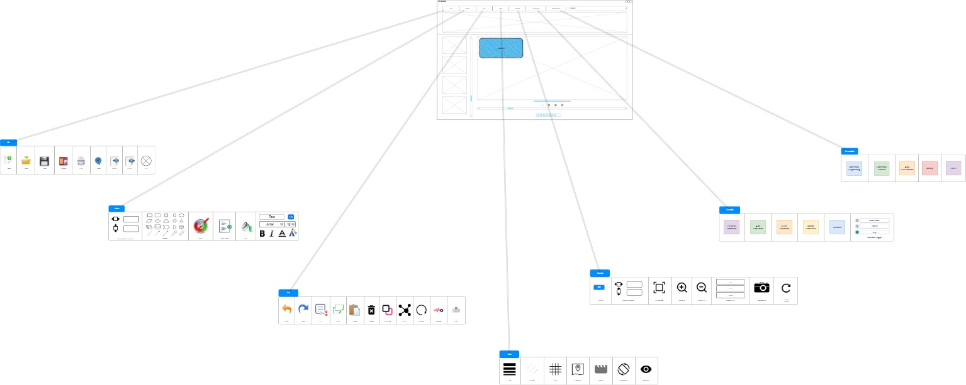
Overview
Sequence
Class
State
Wireframe
Use case
Divide

Slide 14
Iteration 1 (Due Nov. 16)
Container
Objects & Properties
States
Attributes
Features
Edit Mode
Transitions
Future
Class
Sequence
State
Wireframe
Use case
Divide
Iteration 2 (Due Nov. 30)
Timeline
Camera
Camera Movement
Presentation Mode
Bug Review
Testing

Slide 15
THANKYOU
Future
Class
Future
Sequence
State
Wireframe
Use case
Divide

